Slide 1
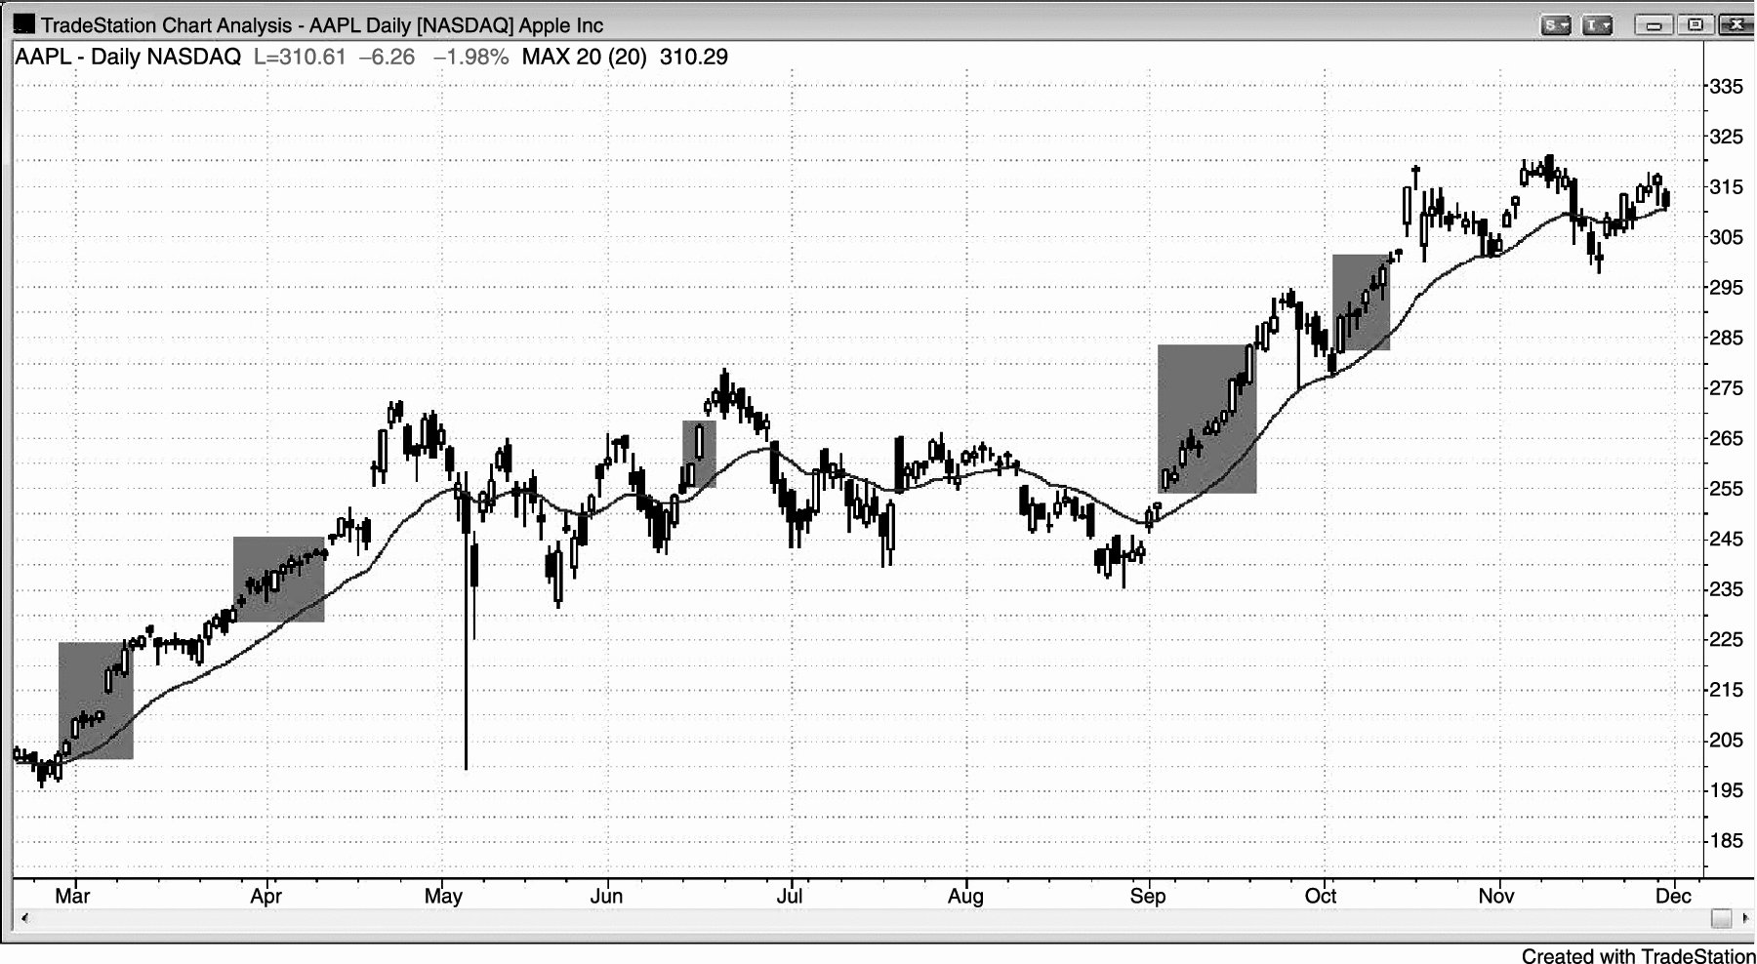
FIGURE 23.1 Buy Calls during Bull Spikes

Slide 2
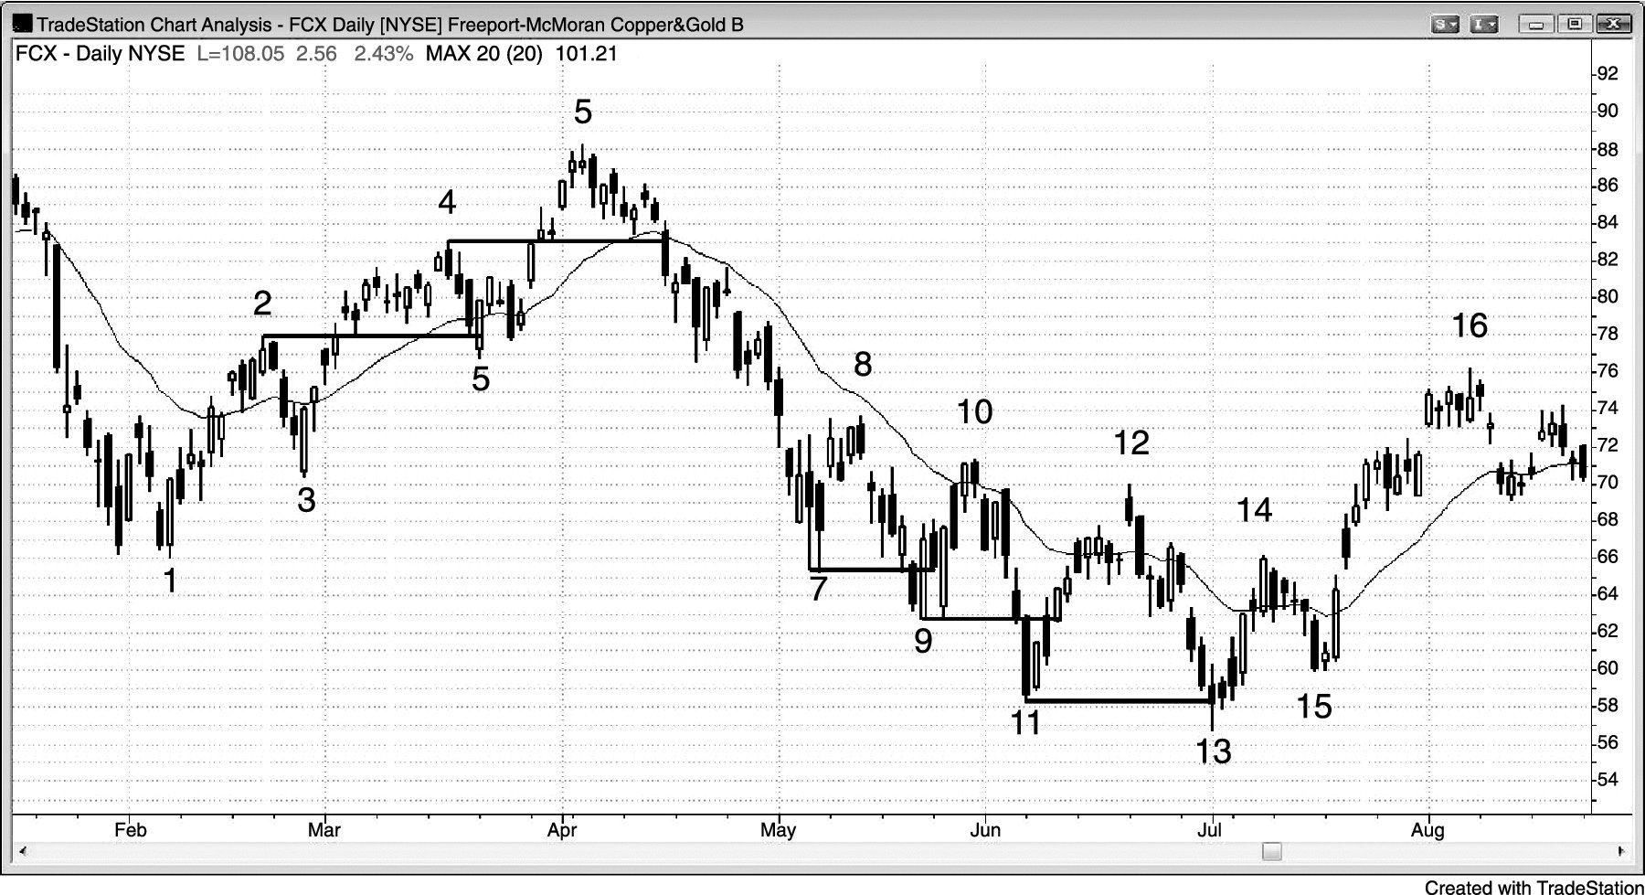
FIGURE 23.2 Fade Stair Breakouts with Options

Slide 3
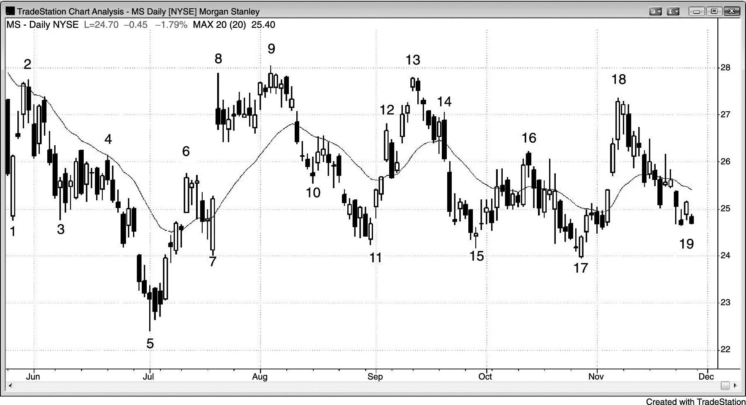
FIGURE 23.3 Fade Trading Range Extremes with Options

Slide 4
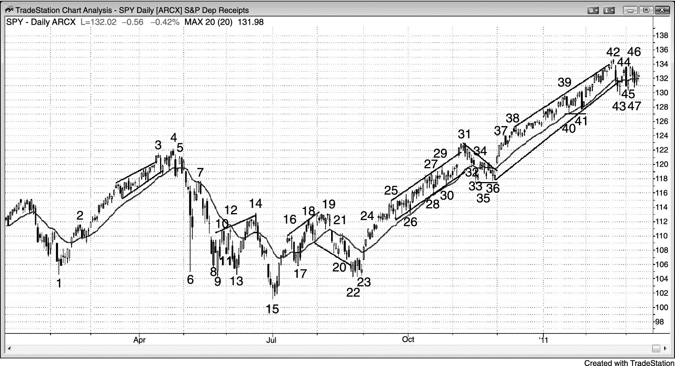
FIGURE 23.4 The SPY Is a Good Market for Options

Slide 5
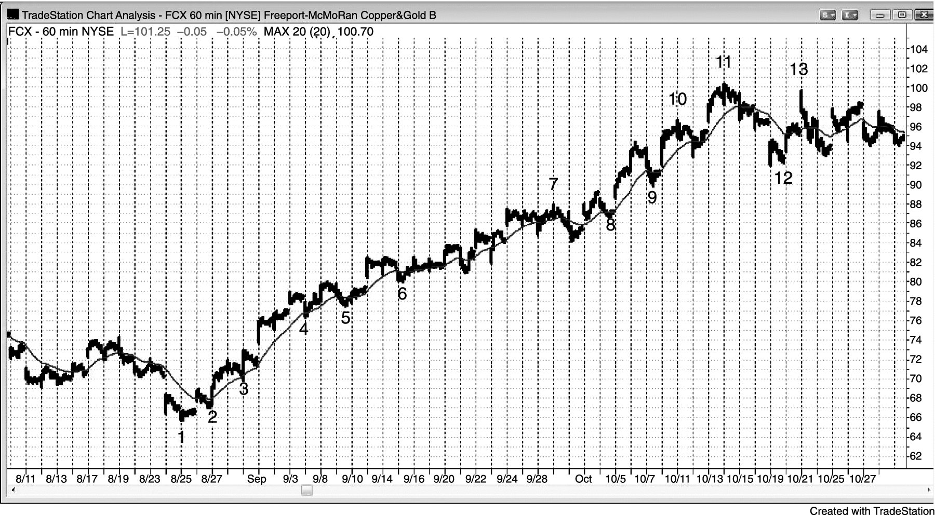
FIGURE 23.5 Buy Calls on Pullbacks to the Moving Average in a Bull Trend

Slide 6
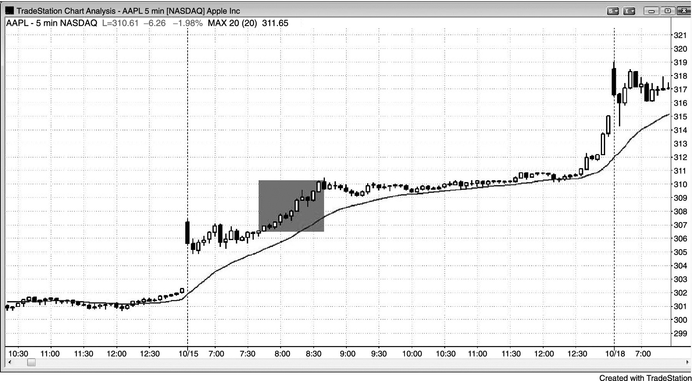
FIGURE 23.6 Buying Calls for a Day Trade

Slide 7
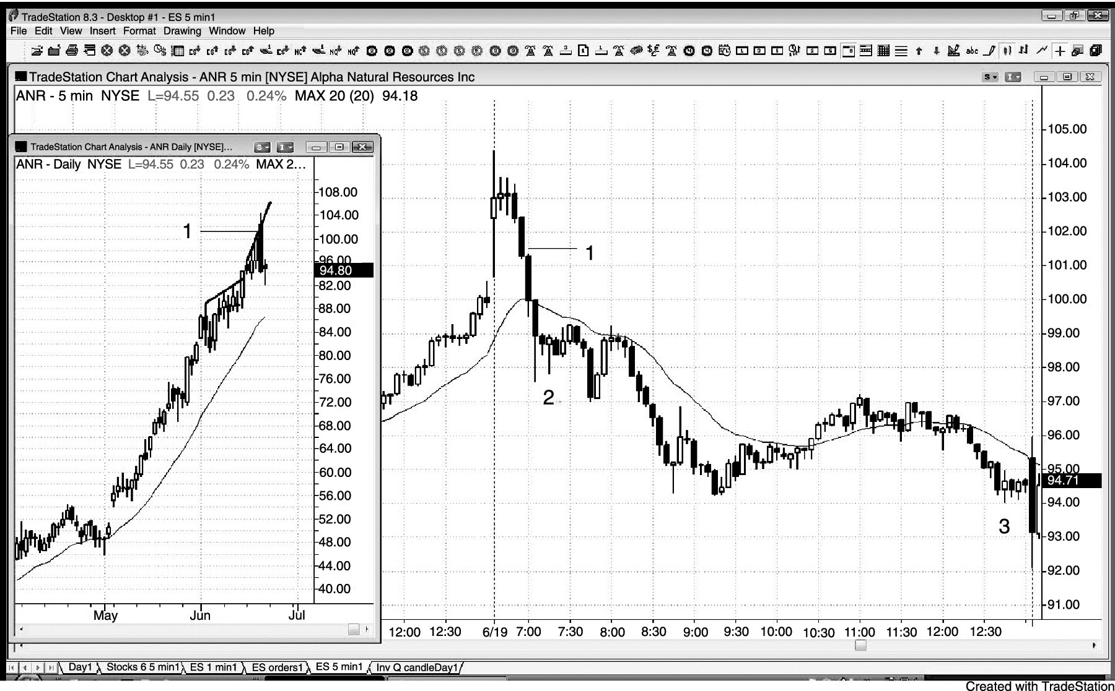
FIGURE 23.7 Day Trade Runaway Trends with Options

Slide 8
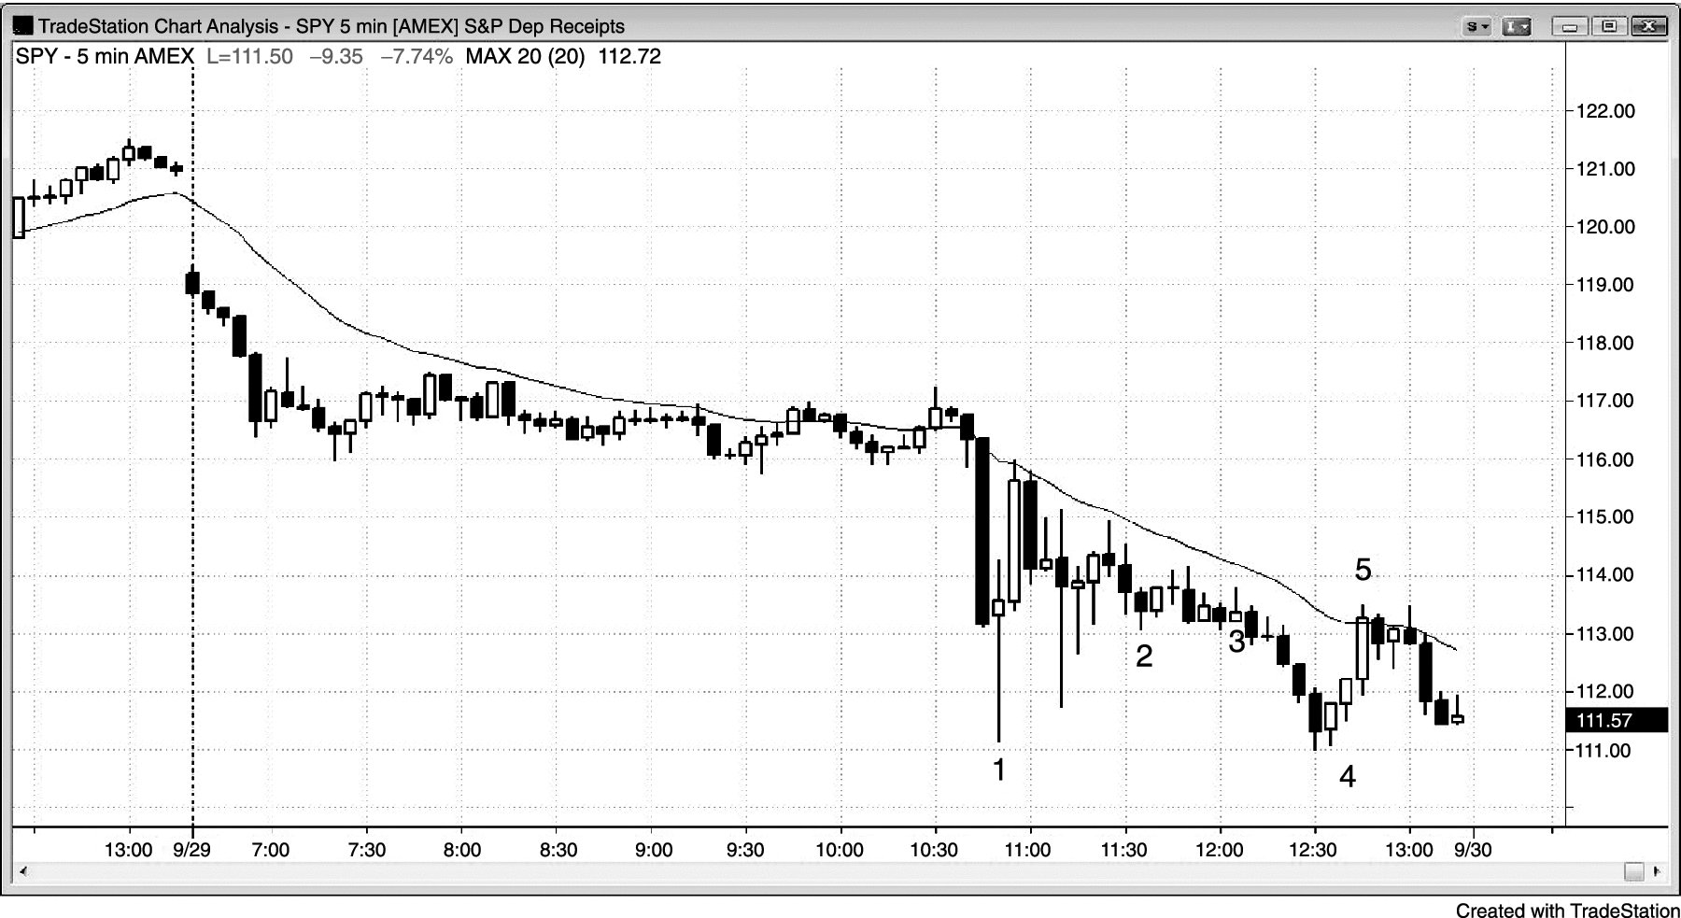
FIGURE 23.8 In Volatile Intraday Moves, Consider Options

Slide 9
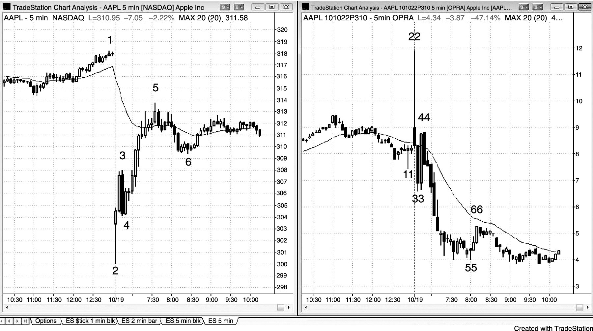
FIGURE 23.9 AAPL Dropped on Earnings but Puts Did Not Rise

